Slide 1

Module 3
Symmetric
Ciphers
5.<number>
Copyright © The McGraw-Hill Companies, Inc. Permission required for reproduction or display.

Slide 2
Objectives
❏ To distinguish between traditional and modern
symmetric-key ciphers.
❏ To introduce modern block ciphers and discuss
their characteristics.
❏ To explain why modern block ciphers need to be
designed as substitution ciphers.
❏ To introduce components of block ciphers such as
P-boxes and S-boxes.
5.<number>

Slide 3
Objectives (Continued)
❏ To discuss product ciphers and distinguish
between two classes of product ciphers:
  Feistel and non-Feistel ciphers.
  ❏ DES (Data Encryption Standard) Algorithm -Symmetric Key Block Cipher (Feistel Product Cipher)
5.<number>

Slide 4
5-1 MODERN BLOCK CIPHERS
A symmetric-key modern block cipher encrypts an
n-bit block of plaintext or decrypts an n-bit block of ciphertext. The encryption or decryption algorithm uses a k-bit key.
Topics discussed in this section:
5.1.1 Substitution or Transposition
5.1.2 Block Ciphers as Permutation Groups
5.1.3 Components of a Modern Block Cipher
5.1.4 Product Ciphers
5.1.5 Two Classes of Product Ciphers
5.<number>

Slide 5
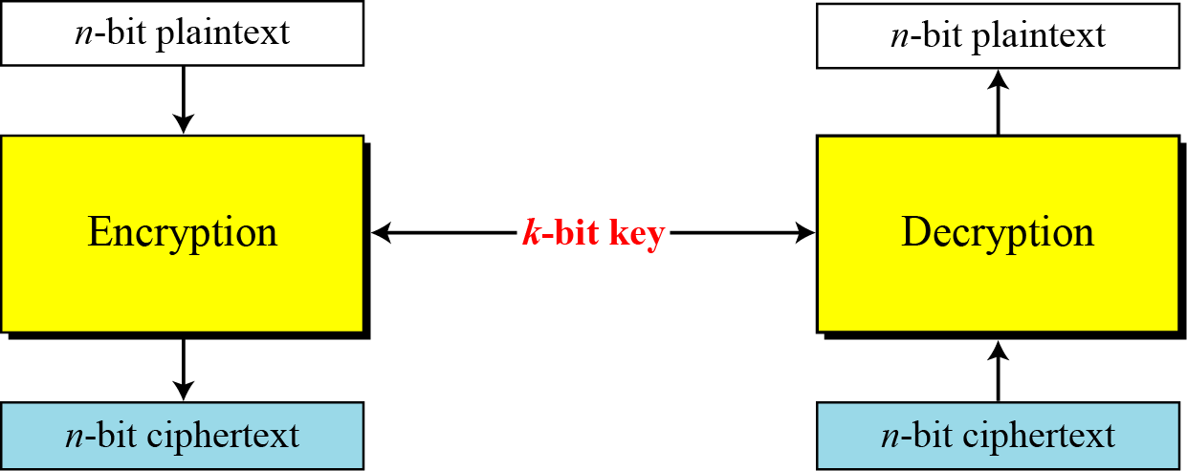
5.1 Continued
Figure 5.1 A modern block cipher
5.<number>

Slide 6
5.1 Continued
Example 5.1
How many padding bits must be added to a message of 100 characters if 8-bit ASCII is used for encoding and the block cipher accepts blocks of 64 bits?
Solution
Encoding 100 characters using 8-bit ASCII results in an 800-bit message. The plaintext must be divisible by 64. If | M | and |Pad| are the length of the message and the length of the padding,
5.<number>

Slide 7
Substitution or Transposition
Substitution
  1-bit / 0 – bit in plaintext replaced by 0-bit/ 1 –bit
  Plaintext and Ciphertext will have different number of 1’s
  Ex : 64 bit plaintext block -> 12 0’s and 52 1’s . Ciphertext -> 34 0’s and 30 1’s
  Preferred than transposition
Transposition
  Bits are only reordered (transposed).
  Same number of 1’s in plaintext/ciphertext
  Preserving no of 1’s and 0’s makes cipher vulnerable to exhaustive search attacks
  No of n-bit possible plaintext or cipher text is 2^{n} .Each n bit in the block can have 2 values 0 or 1

Slide 8

5.1.1 Substitution or Transposition
A modern block cipher can be designed to act as a substitution cipher or a transposition cipher.
Note
To be resistant to exhaustive-search attack,
a modern block cipher needs to be
designed as a substitution cipher.
5.<number>

Slide 9
5.1.1 Continued
Example 5.2
Suppose that we have a block cipher where n = 64. If there are 10 1’s in the ciphertext, how many trial-and-error tests does Eve need to do to recover the plaintext from the intercepted ciphertext in each of the following cases?
a. The cipher is designed as a substitution cipher.
b. The cipher is designed as a transposition cipher.
Solution
In the first case, Eve has no idea how many 1’s are in the plaintext. Eve needs to try all possible 264 64-bit blocks to find one that makes sense.
In the second case, Eve knows that there are exactly 10 1’s in the plaintext. Eve can launch an exhaustive-search attack using only those 64-bit blocks that have exactly 10 1’s.
5.<number>

Slide 10
Components of Modern Block Cipher
To satisfy properties of Diffusion & Confusion
Made of Combination of
  Transposition units (P-boxes),
  Substitution units (S-boxes) etc…

Slide 11
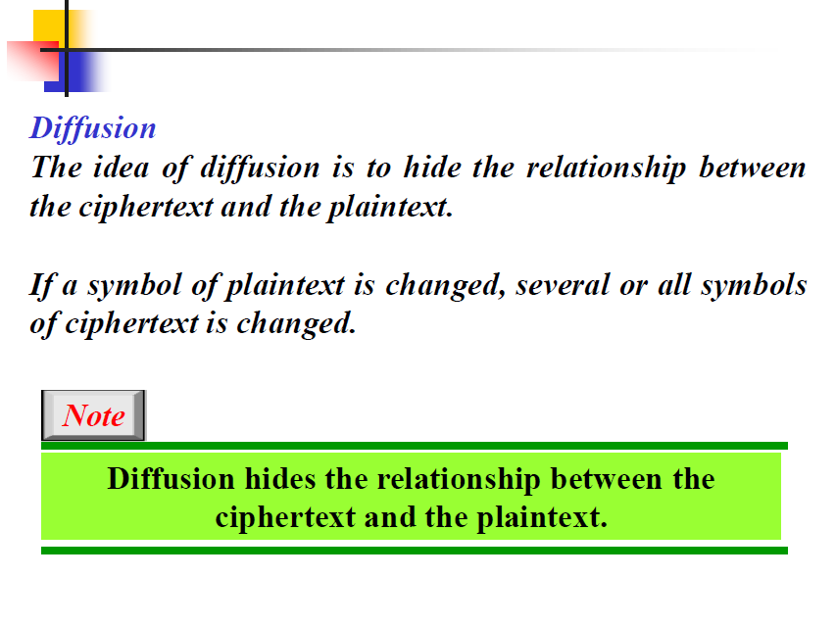


Slide 12
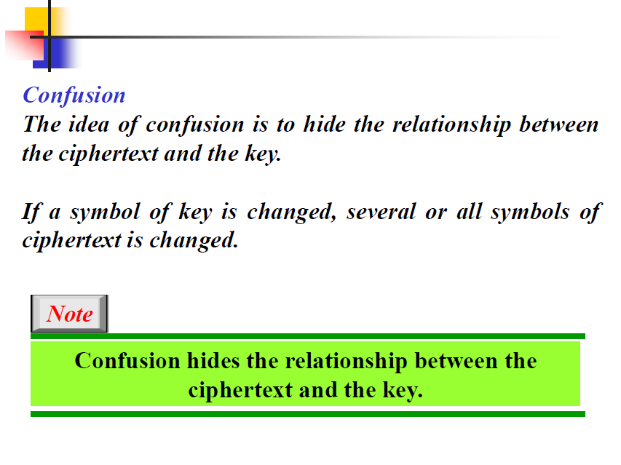

Slide 13
5.1.3 Components of a Modern Block Cipher
P-Boxes
A P-box (permutation box) parallels the traditional transposition cipher for characters.
It transposes bits.
5.<number>

Slide 14
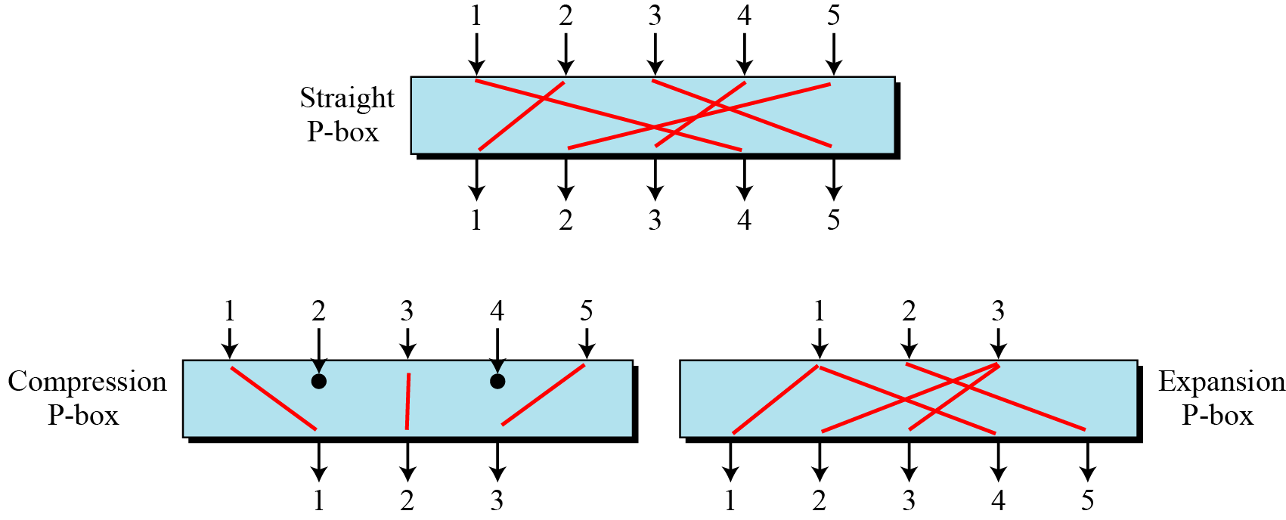
Figure 5.4 Three types of P-boxes
5.<number>

Slide 15
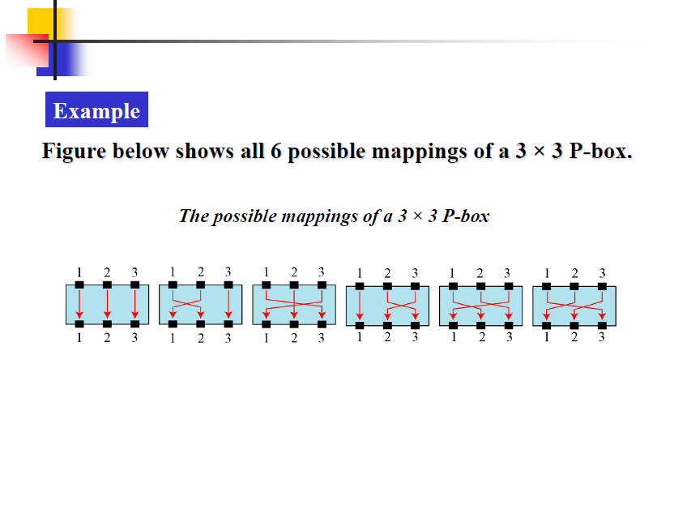
Straight P-Box
n inputs and n-outputs permutation
n! possible mappings. But mapping is predetermined as it’s keyless

Slide 16
Keyless ciphers
Keyless Transposition ciphers
  Fixed Key
  Prewired transposition ciphers when implemented in hardware
  Represented as table when implemented in software
  Ex : P- Boxes
Keyless Substitution ciphers
  Fixed key
  Predefined mapping from input to output
  Defined as table, mathematical function etc..
  Ex : S-boxes

Slide 17
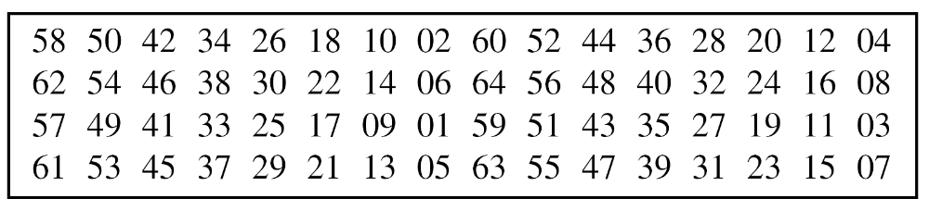
5.1.3 Continued
Straight P-Boxes
Example of a permutation table for a straight P-box when n = 64
64 entries corresponding to the 64 inputs.
Position or index corresponds to the output
5.<number>

Slide 18
5.1.2 Continued
Example 5.6
Design an 8 × 8 permutation table for a straight P-box that moves the two middle bits (bits 4 and 5) in the input word to the two ends (bits 1 and 8) in the output words. Relative positions of other bits should not be changed.
Solution
We need a straight P-box with the table [4 1 2 3 6 7 8 5]. The relative positions of input bits 1, 2, 3, 6, 7, and 8 have not been changed, but the first output takes the fourth input and the eighth output takes the fifth input.
5.<number>

Slide 19
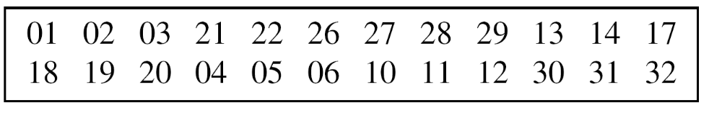
5.1.3 Continued
Compression P-Boxes
A compression P-box is a P-box with n inputs and m outputs where m < n.
Example of a 32 × 24 permutation table
Some of the inputs are blocked and do not reach output
Here inputs 7,8,9,15,16,23,24,25 are blocked
Compression P-Box are used when we need to permute bits and
same time decrease the number of bits for next stage
5.<number>

Slide 20
5.1.3 Continued
Expansion P-Boxes
An expansion P-box is a P-box with n inputs and m outputs where m > n.
Example of a 12 × 16 permutation table
Table has m entries, but m-n entries are repeated,
Those inputs mapped to more than one output
Expansion P-Box are used when we need to transpose bits and
same time increase the number of bits for next stage
5.<number>

Slide 21
5.1.3 Continued
P-Boxes: Invertibility
Note
A straight P-box is invertible, but compression and expansion P-boxes are not.
compression is not the inverse of expansion P-boxes or vice-versa.
5.<number>

Slide 22
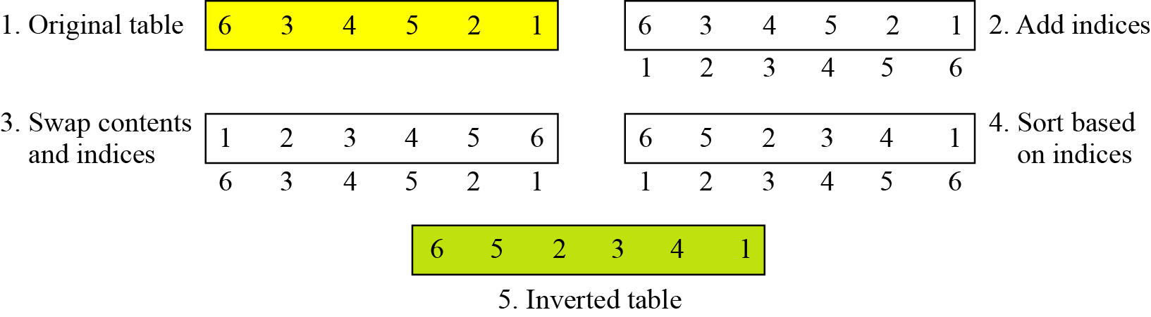
5.1.3 Continued
Example 5.7
Figure 5.6 shows how to invert a permutation table represented as a one-dimensional table.
Figure 5.6 Inverting a permutation table
5.<number>

Slide 23
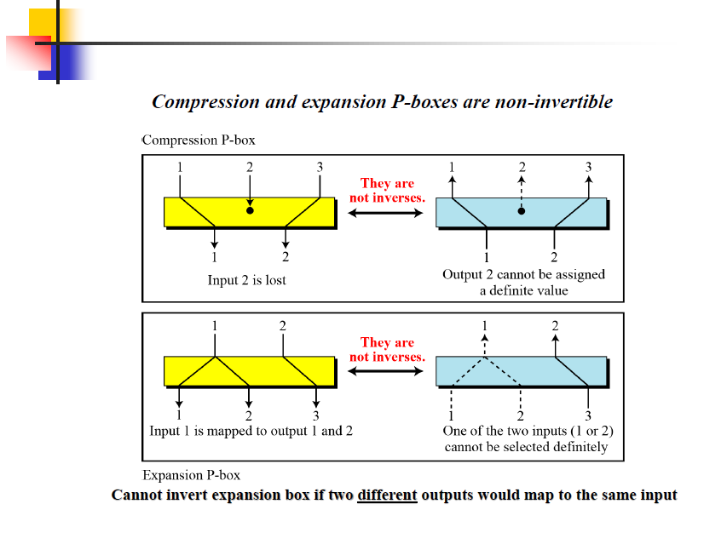
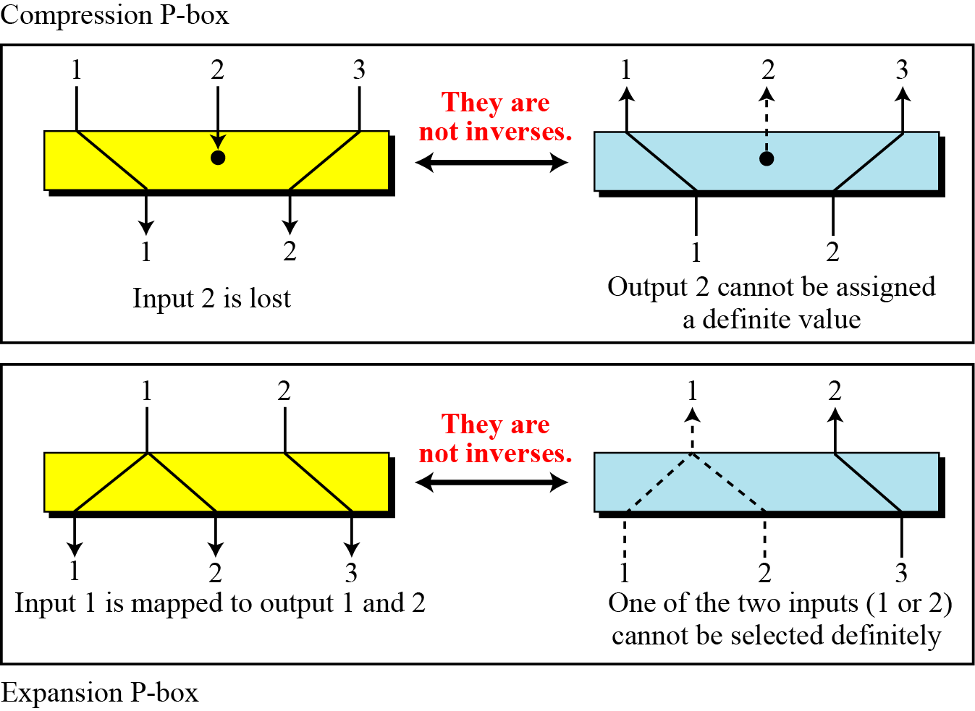
5.1.3 Continued
Figure 5.7 Compression and expansion P-boxes are non-invertible
5.<number>

Slide 24
5.1.3 Continued
S-Box
An S-box (substitution box) can be thought of as a miniature substitution cipher.
Note
An S-box is an m × n substitution unit, where m and n are not necessarily the same.
5.<number>

Slide 25
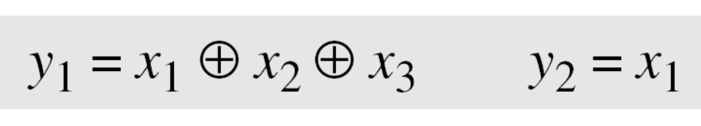
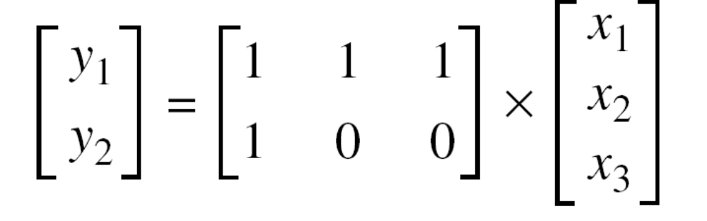
5.1.3 Continued
S-Boxes: Linear vs Non-Linear S-Boxes
Example 5.8
In an S-box with three inputs and two outputs, we have
The S-box is linear because a_{1,1} = a_{1,2} = a_{1,3} = a_{2,1} = 1 and
a_{2,2} = a_{2,3} = 0. The relationship can be represented by matrices, as shown below:
5.<number>

Slide 26
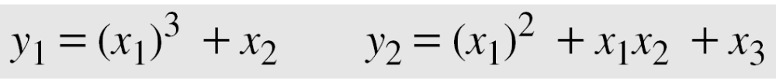
5.1.3 Continued
Example 5.9
In an S-box with three inputs and two outputs, we have
where multiplication and addition is in GF(2). The S-box is nonlinear because there is no linear relationship between the inputs and the outputs.
5.<number>

Slide 27
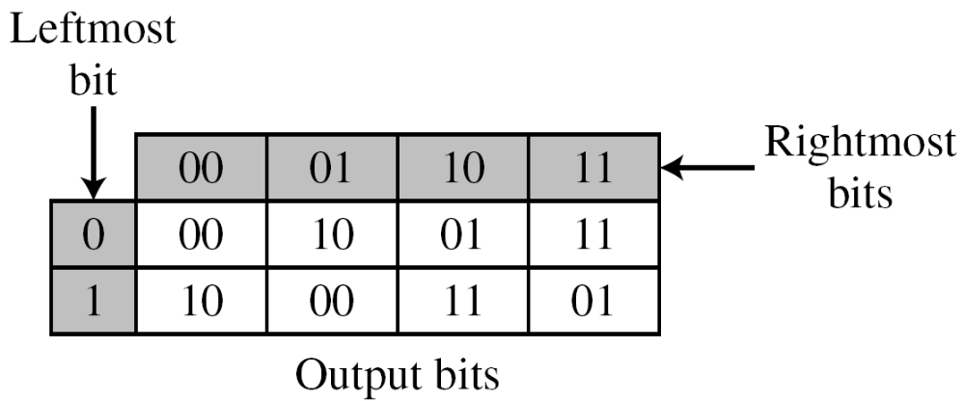
5.1.3 Continued
Example 5.10
The following table defines the input/output relationship for an S-box of size 3 × 2. The leftmost bit of the input defines the row; the two rightmost bits of the input define the column. The two output bits are values on the cross section of the selected row and column.
Based on the table, an input of 010 yields the output 01. An input of 101 yields the output of 00.
5.<number>

Slide 28
5.1.3 Continued
S-Boxes: Invertibility
An S-box may or may not be invertible. In an invertible
S-box, the number of input bits should be the same as the number of output bits.
5.<number>

Slide 29
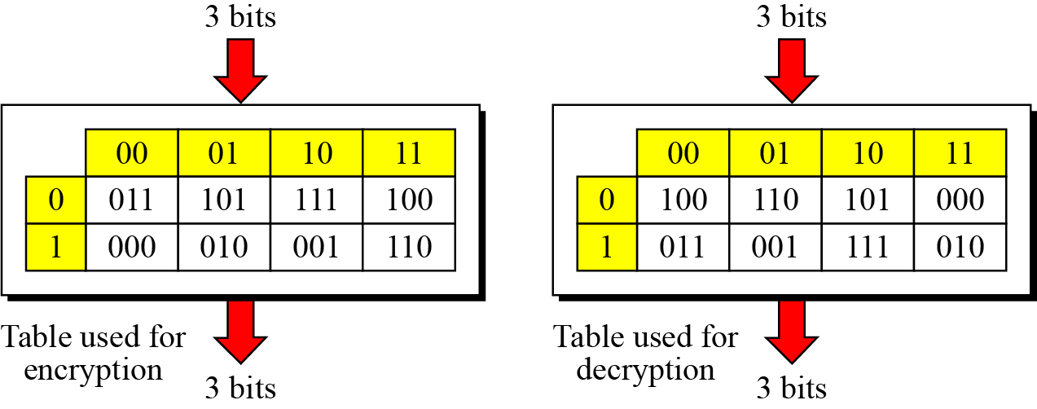
5.1.3 Continued
Example 5.11
Figure 5.8 shows an example of an invertible S-box. For example, if the input to the left box is 001, the output is 101. The input 101 in the right table creates the output 001, which shows that the two tables are inverses of each other.
Figure 5.8 S-box tables for Example 5.11
5.<number>

Slide 30
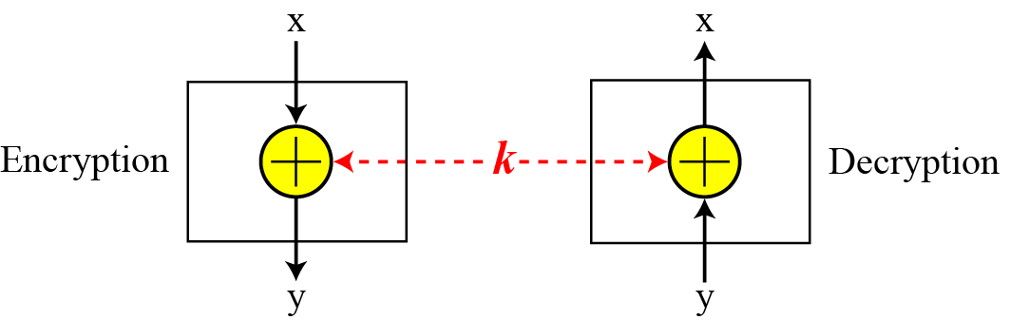
5.1.3 Continued
Exclusive-Or
An important component in most block ciphers is the exclusive-or operation.
Figure 5.9 Invertibility of the exclusive-or operation
5.<number>

Slide 31
5.1.3 Continued
Exclusive-Or (Continued)
An important component in most block ciphers is the exclusive-or operation, addition and subtraction operations in the GF(2n) field are performed by a single operation called the exclusive-or (XOR).
The five properties of the exclusive-or operation in the GF(2n) field makes this operation a very interesting component for use in a block cipher: closure, associativity, commutativity, existence of identity, and existence of inverse.
5.<number>

Slide 32
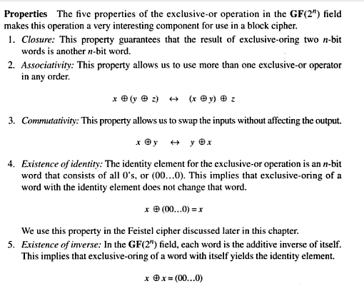

Slide 33
5.1.3 Continued
Exclusive-Or (Continued)
The inverse of a component in a cipher makes sense if the component represents a unary operation (one input and one output). For example, a keyless P-box or a keyless S-box can be made invertible because they have one input and one output. An exclusive operation is a binary operation. The inverse of an exclusive-or operation can
make sense only if one of the inputs is fixed (is the same in encryption and decryption). For example, if one of the inputs is the key, which normally is the same in encryption and decryption, then an exclusive-or operation is self-invertible,.
5.<number>

Slide 34
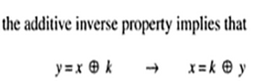
5.1.1 Continued
Figure 5.9 Invertibility of the exclusive-or operation
XOR - self-invertible,
5.<number>

Slide 35
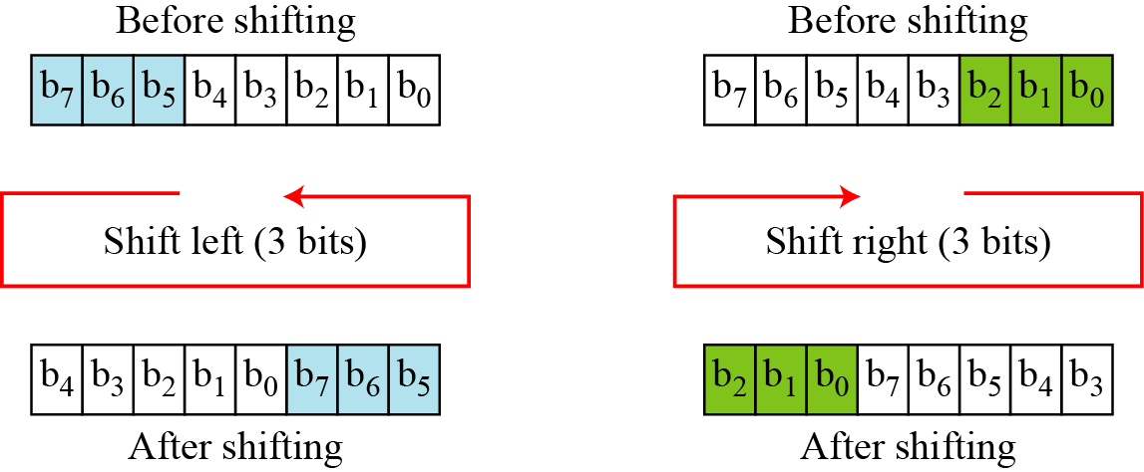
5.1.3 Continued
Circular Shift
Another component found in some modern block ciphers is the circular shift operation.
Figure 5.10 Circular shifting an 8-bit word to the left or right
5.<number>

Slide 36
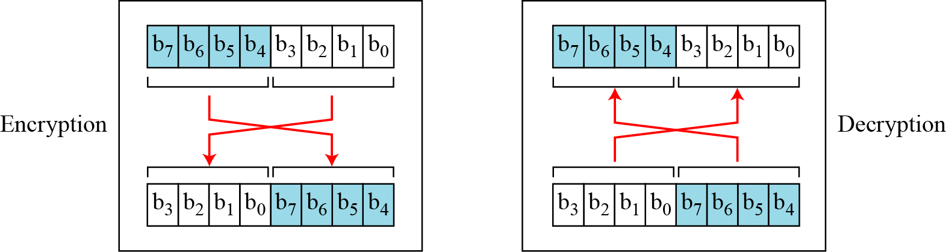
5.1.3 Continued
Swap
The swap operation is a special case of the circular shift operation where k = n/2.
Figure 5.11 Swap operation on an 8-bit word
5.<number>

Slide 37
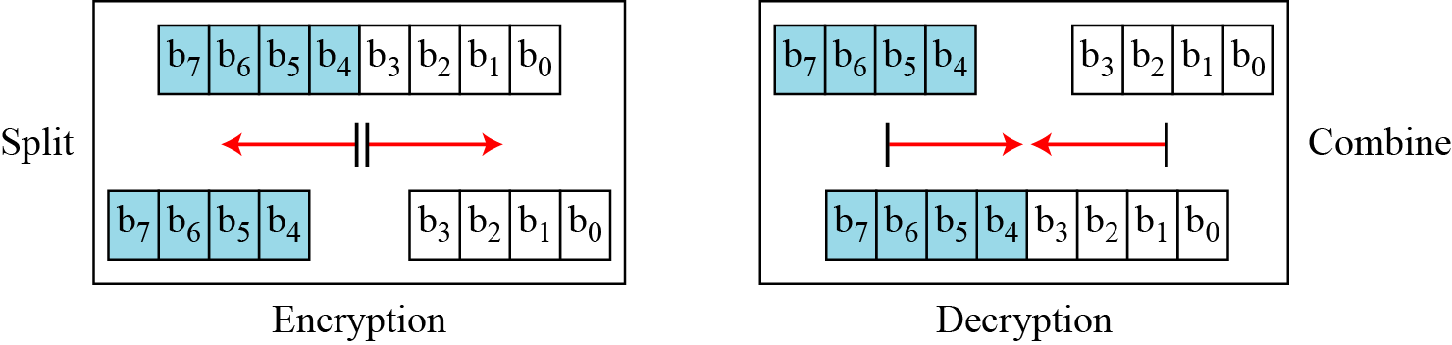
5.1.3 Continued
Split and Combine
Two other operations found in some block ciphers are split and combine.
Figure 5.12 Split and combine operations on an 8-bit word
5.<number>

Slide 38
5.1.3 Continued
Figure 5.12 Split and combine operations on an 8-bit word
5.<number>

Slide 39
5.1.4 Product Ciphers
Shannon introduced the concept of a product cipher.
A product cipher is a complex cipher combining substitution, permutation, and other components.
5.<number>

Slide 40
5.1.4 Continued
Diffusion
The idea of diffusion is to hide the relationship between the ciphertext and the plaintext.
Note
Diffusion hides the relationship between the ciphertext and the plaintext.
Diffusion implies that each symbol (character or bit) in the ciphertext is dependent on some or all symbols in the plaintext.
if a single symbol in the plaintext is changed, several or all symbols in the ciphertext will also be changed
5.<number>

Slide 41
5.1.4 Continued
Confusion
The idea of confusion is to hide the relationship between the ciphertext and the key.
Note
Confusion hides the relationship between the ciphertext and the key.
if a single bit in the key is changed, most or all bits in the ciphertext will also be changed.
5.<number>

Slide 42
5.1.4 Continued
Rounds
Diffusion and confusion can be achieved using iterated product ciphers where each iteration is a combination of S-boxes, P-boxes, and other components.
5.<number>

Slide 43
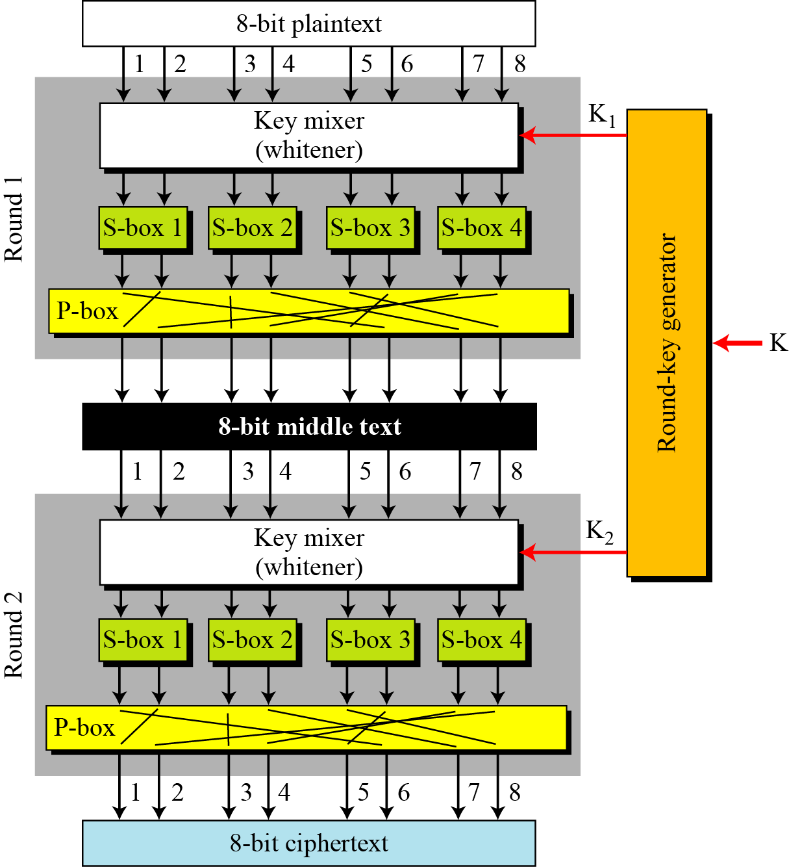
5.1.4 Continued
Ex : A product cipher made of two rounds
5.<number>

Slide 44
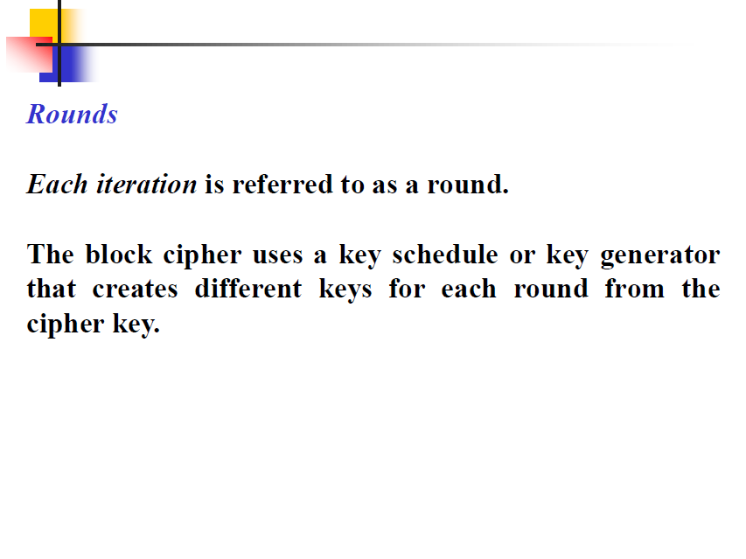

Slide 45
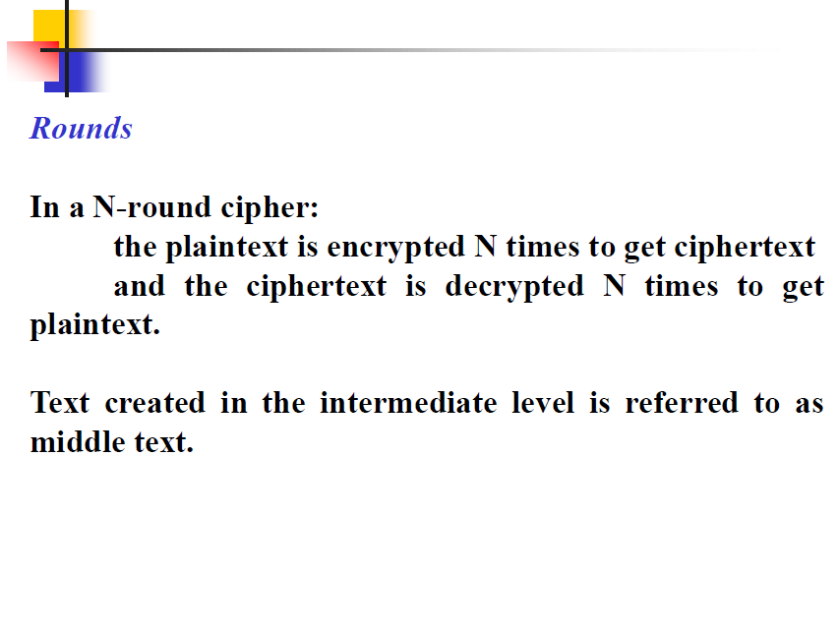

Slide 46
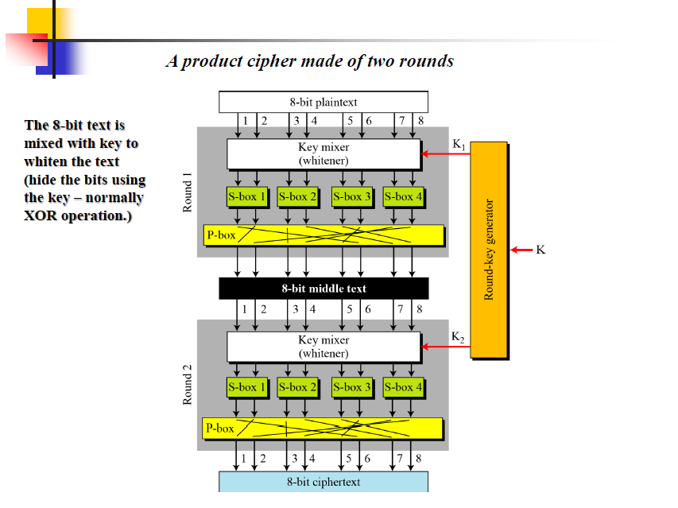

Slide 47
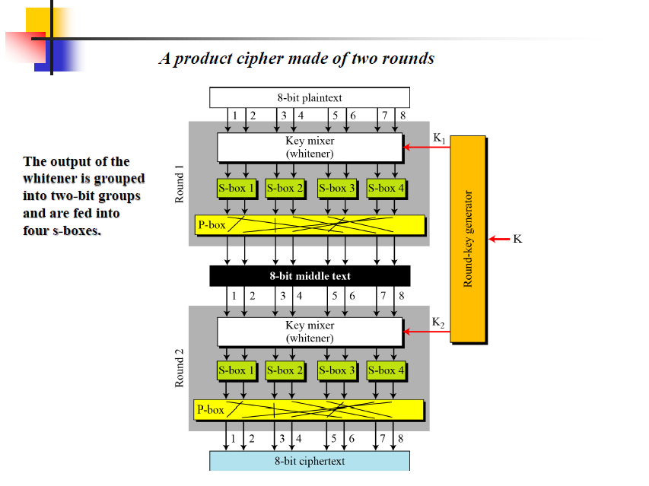

Slide 48
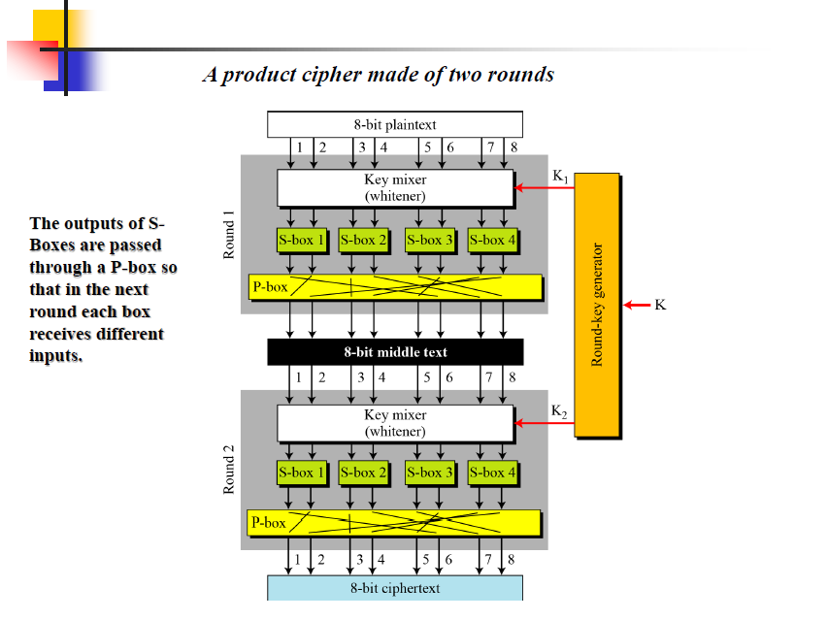

Slide 49
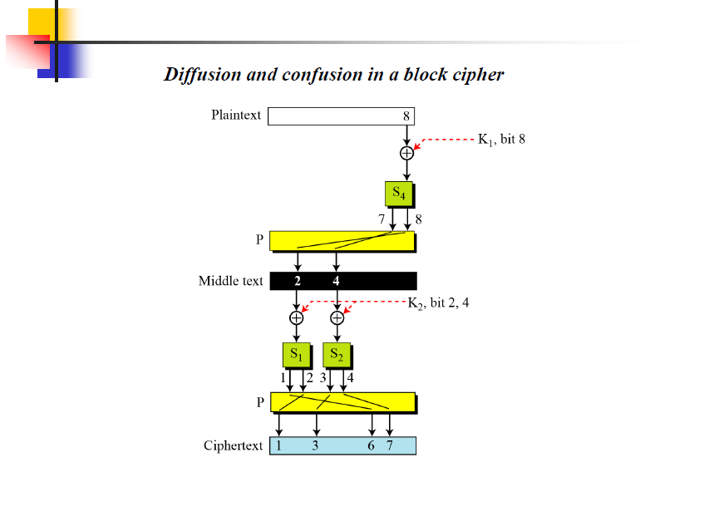
Diffusion guaranteed : Changing a single bit in the plaintext affects many bits in the ciphertext.
affects two bits

Slide 50
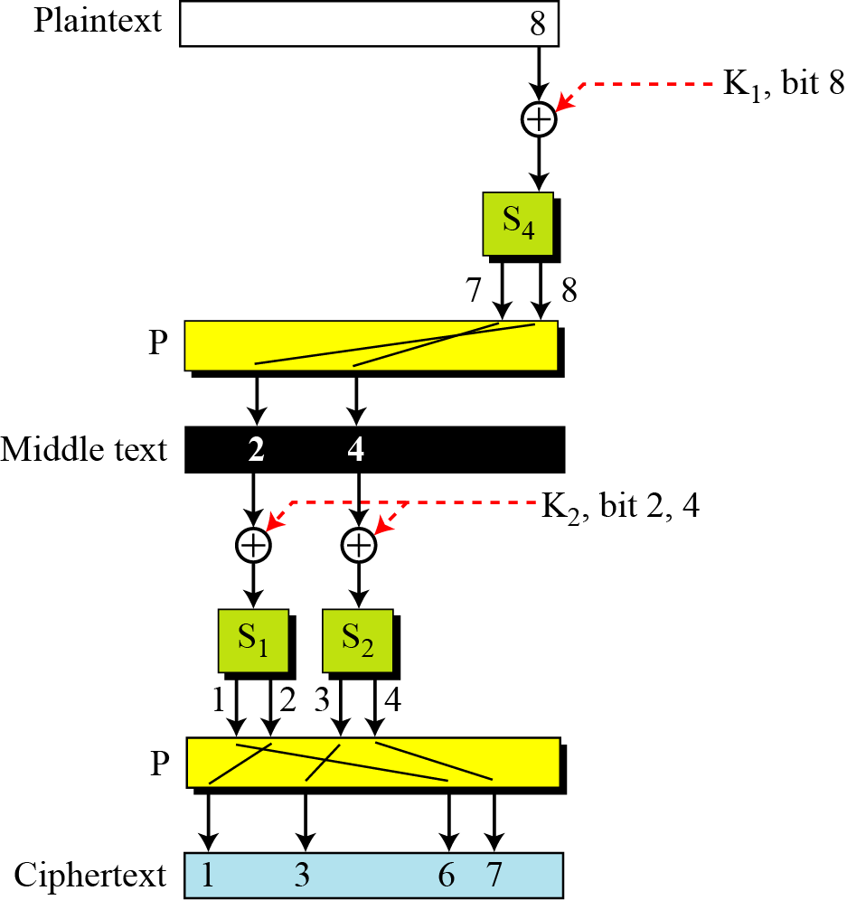
5.1.4 Continued
Figure 5.14 Diffusion and confusion in a block cipher
each bit in each round key affects
several bits in the ciphertext.
5.<number>

Slide 51
To improve diffusion and confusion,
Practical ciphers use larger data blocks, more S-boxes, and more rounds.
increasing the number of rounds using more S-boxes may create a better cipher in which the ciphertext looks more and more like a random n-bit word.
In this way, the relationship between ciphertext and plaintext is totally hidden (diffusion).
Increasing the number of rounds increases the number of round keys, which better hides the relationship between the ciphertext and the key
5.<number>

Slide 52
5.1.5 Two Classes of Product Ciphers
Modern block ciphers are all product ciphers, but they are divided into two classes.
1. Feistel ciphers
2. Non-Feistel ciphers
5.<number>

Slide 53
5.1.5 Continued
Feistel Ciphers
Feistel designed a very intelligent and interesting cipher that has been used for decades. A Feistel cipher can have three types of components: self-invertible, invertible, and
noninvertible.
5.<number>

Slide 54
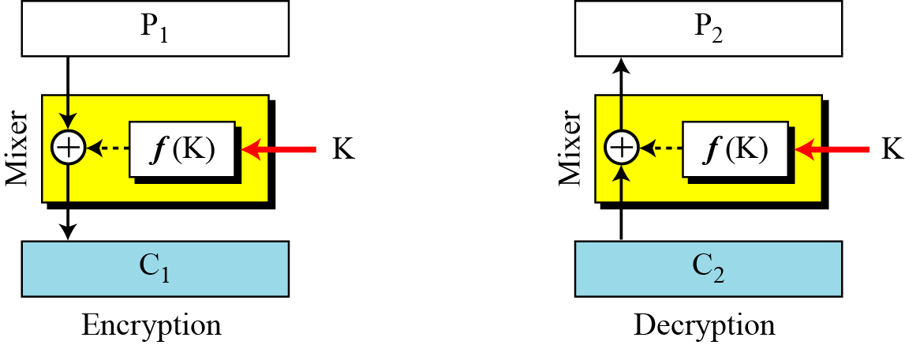
5.1.5 Continued
Figure 5.15 The first thought in Feistel cipher design
a noninvertible function, ƒ(K), accepts the key as the input
although the mixer has a noninvertible element, the mixer itself is self-invertible.
How we can use the same noninvertible component in the encryption and decryption algorithms?
The effects of a noninvertible component in the encryption algorithm can be canceled in the decryption algorithm if we use an exclusive-or operation
5.<number>

Slide 55

5.1.5 Continued
Figure 5.15 The first thought in Feistel cipher design
a noninvertible function, ƒ(K), accepts the key as the input
although the mixer has a noninvertible element,
the mixer in Fiestel Design is self-invertible.
5.<number>

Slide 56
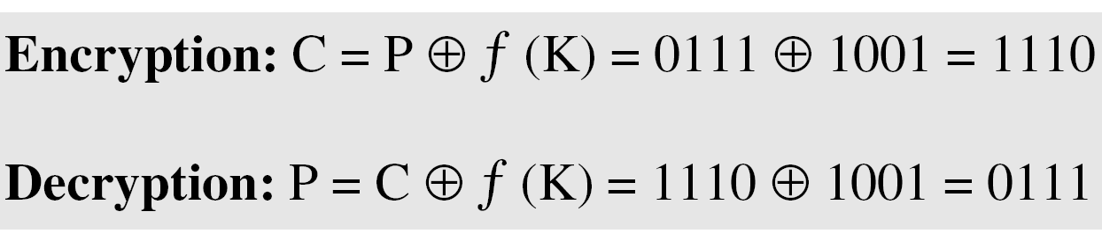
5.1.3 Continued
Example 5.12
This is a trivial example. The plaintext and ciphertext are each 4 bits long and the key is 3 bits long. Assume that the function takes the first and third bits of the key, interprets these two bits as a decimal number, squares the number, and interprets the result as a 4-bit binary pattern. Show the results of encryption and decryption if the original plaintext is 0111 and the key is 101.
Solution
The function extracts the first and second bits to get 11 in binary or 3 in decimal. The result of squaring is 9, which is 1001 in binary.
5.<number>

Slide 57
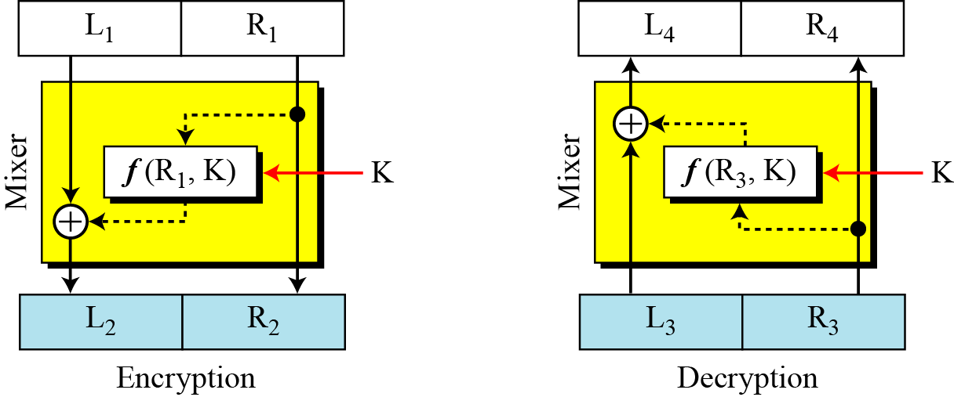
5.1.5 Continued
Figure 5.16 Improvement of the previous Feistel design
5.<number>

Slide 58
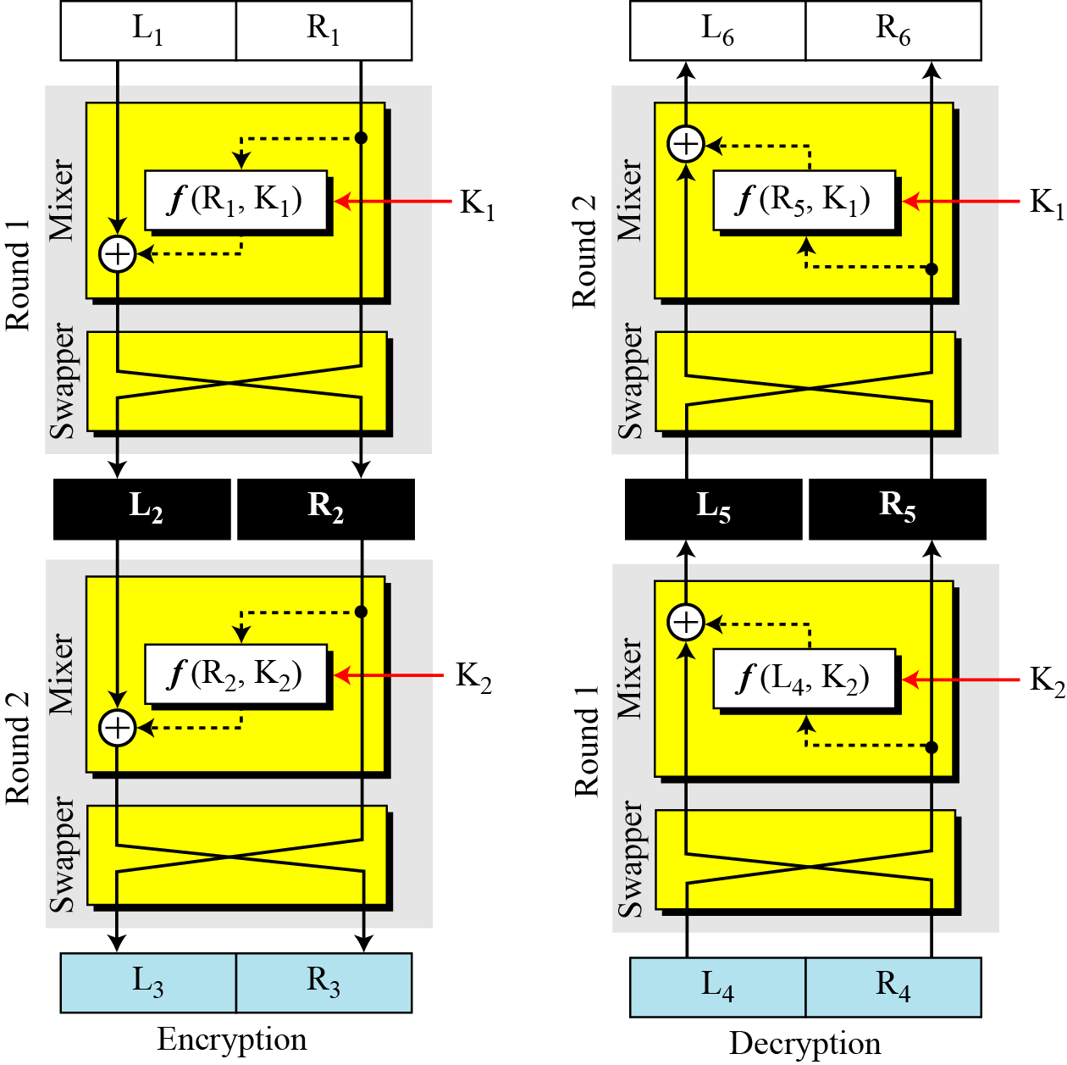
5.1.5 Continued
Figure 5.17 Final design of a Feistel cipher with two rounds
5.<number>

Slide 59
5.1.5 Continued
Non-Feistel Ciphers
A non-Feistel cipher uses only invertible components. A component in the encryption cipher has the corresponding component in the decryption cipher.
5.<number>

Slide 60
Data Encryption Standard (DES)
6.<number>
Copyright © The McGraw-Hill Companies, Inc. Permission required for reproduction or display.

Slide 61
Objectives
❏ To review a short history of DES
❏ To define the basic structure of DES
❏ To describe the details of building elements of DES
❏ To describe the round keys generation process
6.<number>

Slide 62
6-1 INTRODUCTION
The Data Encryption Standard (DES) is a symmetric-key block cipher published by the National Institute of Standards and Technology (NIST).
Topics discussed in this section:
6.1.1 History
6.1.2 Overview
6.<number>

Slide 63
6.1.1 History
In 1973, NIST published a request for proposals for a national symmetric-key cryptosystem.
A proposal from IBM, a modification of a project called Lucifer, was accepted as DES.
DES was published in the Federal Register in March 1975 as a draft of the Federal Information Processing Standard (FIPS).
6.<number>

Slide 64

6.1.2 Overview
DES is a block cipher, as shown in Figure 6.1.
Figure 6.1 Encryption and decryption with DES
6.<number>

Slide 65
6-2 DES STRUCTURE
The encryption process is made of two permutations (P-boxes), which we call initial and final permutations, and sixteen Feistel rounds.
Topics discussed in this section:
6.2.1 Initial and Final Permutations
6.2.2 Rounds
6.2.3 Cipher and Reverse Cipher
6.2.4 Examples
6.<number>

Slide 66

6-2 Continue
Figure 6.2 General structure of DES
6.<number>

Slide 67

6.2.1 Initial and Final Permutations
Figure 6.3 Initial and final permutation steps in DES
6.<number>

Slide 68
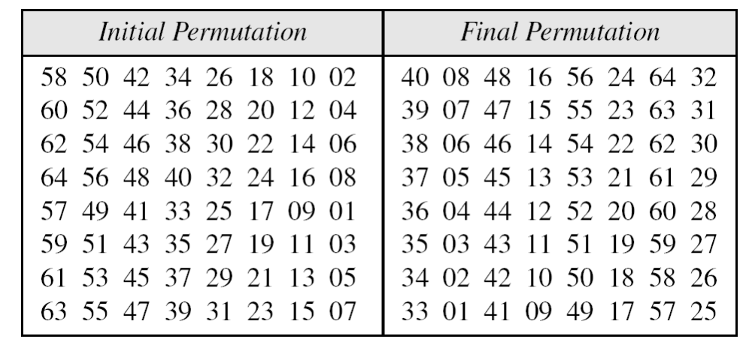
6.2.1 Continue
Both are predetermined and keyless
Thwart software simulation
Table 6.1 Initial and final permutation tables
6.<number>

Slide 69
6.2.1 Continued
Note
The initial and final permutations are straight P-boxes that are inverses
of each other.
They have no cryptography significance in DES.
6.<number>

Slide 70

6.2.2 Rounds
DES uses 16 rounds. Each round of DES is a Feistel cipher.
6.<number>
A round in DES (encryption site)

Slide 71

6.2.2 Continued
DES Function
The heart of DES is the DES function. The DES function applies a 48-bit key to the rightmost 32 bits to produce a 32-bit output.
Figure 6.5
DES function
Heart of DES
Expansion P Box
  Whitener ( adds key)
  S-Boxes
  Straight P-Boxes
6.<number>

Slide 72

6.2.2 Continue
DES FUNCTION → Expansion P-box
Since R_{I−1} is a 32-bit input and K_{I} is a 48-bit key, we first need to expand R_{I−1} to 48 bits.
Figure 6.6 Expansion permutation
Divide into 4 -> 8 bit sections.
Each 4 bit section expanded to 6 bits
1,2,3,4 bits copied to 2,3,4,5 output bits
6.<number>

Slide 73
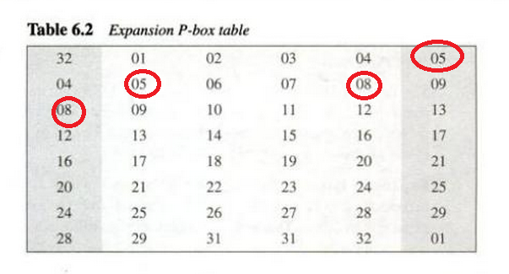
6.2.2 Continue
Although the relationship between the input and output can be defined mathematically, DES uses Table 6.2 to define this P-box.
Table 6.6 Expansion P-box table
6.<number>

Slide 74
6.2.2 Continued
DES Function
The heart of DES is the DES function. The DES function applies a 48-bit key to the rightmost 32 bits to produce a 32-bit output.
Figure 6.5
DES function
Heart of DES
Expansion P Box
  Whitener ( adds key)
  S-Boxes
  Straight P-Boxes
6.<number>

Slide 75
6.2.2 Continue
Whitener (XOR)
After the expansion permutation,
DES uses the XOR operation on the expanded right section and the round key (48-bit).
Note that both the right section and the key are 48-bits in length.
Also note that the round key is used only in this operation.
6.<number>

Slide 76

6.2.2 Continue
S-Boxes
The S-boxes do the real mixing (confusion).
DES uses 8 S-boxes, each with a 6-bit input and a 4-bit output.
Figure 6.7 S-boxes
6.<number>

Slide 77

Divide 48 bit data into 8 , 6bit chunks
Combine 4-bit chunks to form 32 bit text
Substitution in each box follows a pre-determined rule (4 *16 table)
6.<number>
Figure 6.8 S-box rule

Slide 78

6.2.2 Continue
Table 6.3 shows the permutation for S-box 1.
Table 6.3 S-box 1
6.<number>

Slide 79
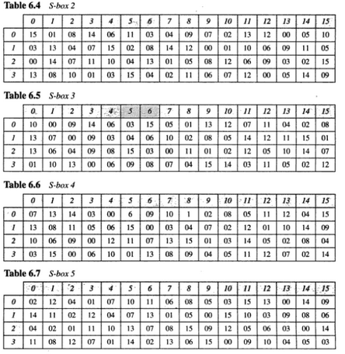
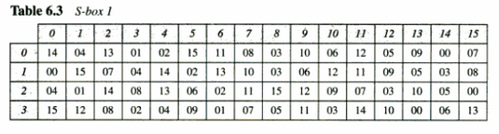
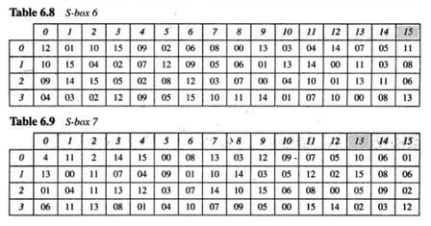
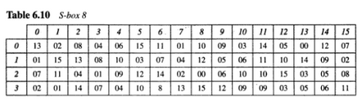

Slide 80
Examples
Input to S-Box 1 is 100011. What is the output?
11 in binary (1st and 6th bits) -> 3 in decimal
0001 -> 1 in decimal
Row 3, Column 1 in S-Box 1 -> 12 in decimal (1100)
100011 → 1100

Slide 81
6.2.2 Continued
Example 6.3
The input to S-box 1 is 100011. What is the output?
Solution
If we write the first and the sixth bits together, we get 11 in binary, which is 3 in decimal. The remaining bits are 0001 in binary, which is 1 in decimal. We look for the value in row 3, column 1, in Table 6.3 (S-box 1). The result is 12 in decimal, which in binary is 1100. So the input 100011 yields the output 1100.
6.<number>

Slide 82
6.2.2 Continue
Table 6.3 shows the permutation for S-box 1.
Table 6.3 S-box 1
6.<number>

Slide 83
6.2.2 Continued
Example 6.4
The input to S-box 8 is 000000. What is the output?
Solution
If we write the first and the sixth bits together, we get 00 in binary, which is 0 in decimal. The remaining bits are 0000 in binary, which is 0 in decimal. We look for the value in row 0, column 0, in Table 6.10 (S-box 8). The result is 13 in decimal, which is 1101 in binary. So the input 000000 yields the output 1101.
6.<number>

Slide 84
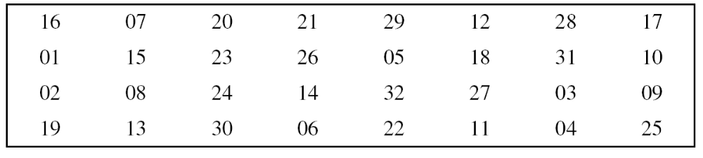
6.2.2 Continue
Straight Permutation
Last operation in function with 32 input/output
Ex : 7th bit of input becomes 2nd bit of output
Table 6.11 Straight permutation table
6.<number>

Slide 85
6.2.3 Cipher and Reverse Cipher
Using mixers and swappers, we can create the cipher and reverse cipher, each having 16 rounds.
First Approach
To achieve this goal, one approach is to make the last round (round 16) different from the others; it has only a mixer and no swapper.
Note
In the first approach, there is no swapper in the last round.
6.<number>

Slide 86

Figure 6.9 DES cipher and reverse cipher for the first approach
Invertibility
Mixer is self-inverse
because of XOR
Swapper, Initial/Final Permutations
are also inverses of each other.
Round keys (K1 to K16)
should be applied
in reverse order
6.<number>

Slide 87
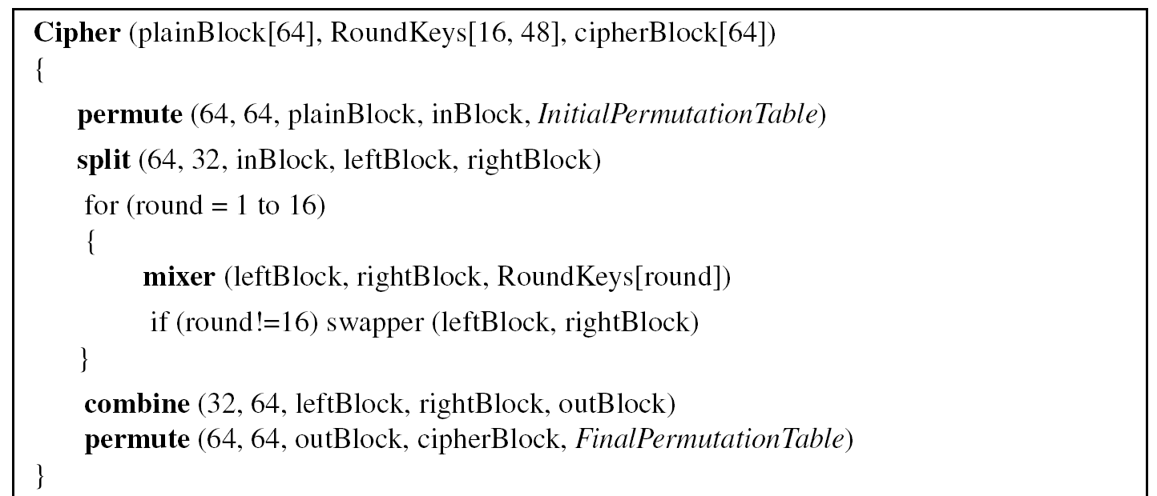
6.2.3 Continued
Algorithm 6.1 Pseudocode for DES cipher
6.<number>

Slide 88
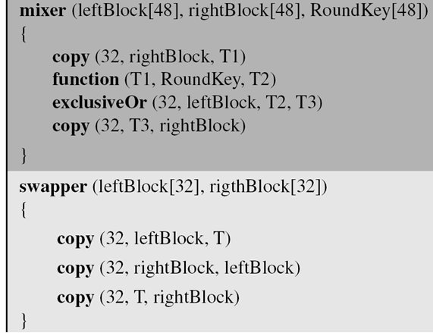
6.2.3 Continued
Algorithm 6.1 Pseudocode for DES cipher (Continued)
6.<number>

Slide 89
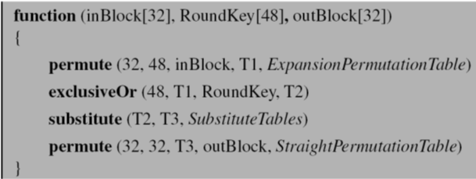
6.2.3 Continued
Algorithm 6.1 Pseudocode for DES cipher (Continued)
6.<number>

Slide 90
6.2.3 Continued
Alternative Approach
We can make all 16 rounds the same by including one swapper to the 16th round and add an extra swapper after that (two swappers cancel the effect of each other).
6.<number>

Slide 91

Key Generation
The round-key
generator creates
sixteen 48-bit keys
out of a 56-bit
cipher key.
6.<number>

Slide 92
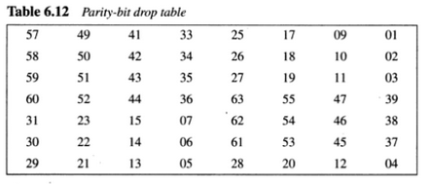
Parity-Drop
Compression permutation – Parity Bit Drop
Drop parity bits (Bits 8,16,24,32 ….. 64) from 64 bit key and permute rest of the bits
Remaining 56 bit value is actual cipher key generates round keys

Slide 93
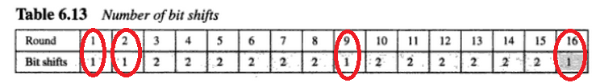
Shift left
56 bit key divided into two 28 bit parts
Each part is left shifted 1 or 2 bits (Circular shift)
28bits are combined to form 56bit part

Slide 94
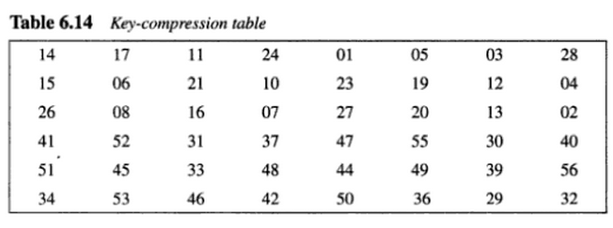
Compression Permutation
P-Box changes 56 bits to 48 bits which are used as keys for a round.

Slide 95
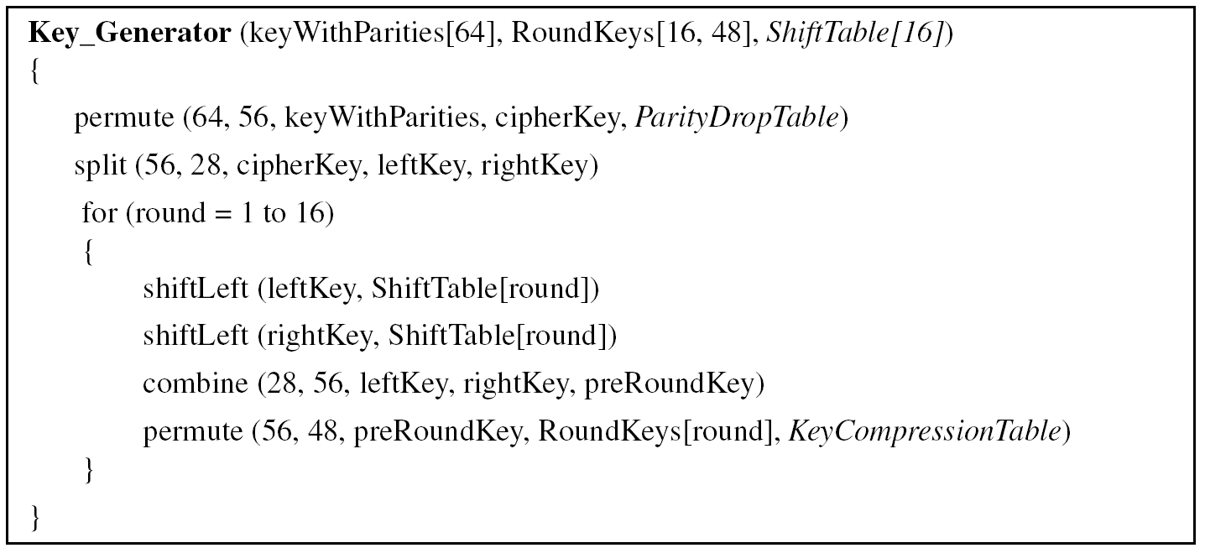
6.2.3 Continued
Algorithm 6.2 Algorithm for round-key generation
6.<number>

Slide 96
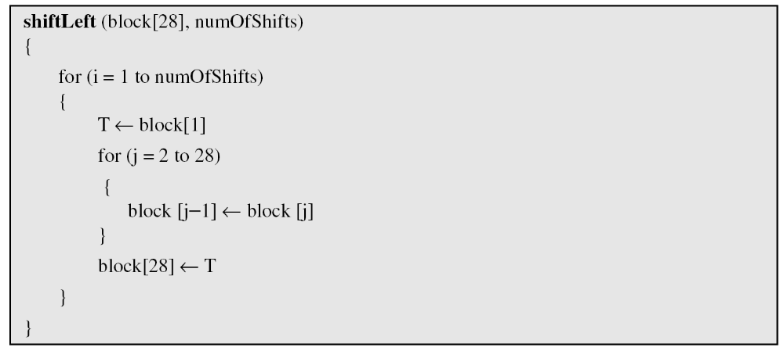
6.2.3 Continued
Algorithm 6.2 Algorithm for round-key generation (Continue)
6.<number>

